Slide 1







STATEC Hackathon
Sarah
THILL
Imen
JEMAII
Jean-Guilhem
DAMONGEOT
Selma
LOPEZ
EY Solution Pitch : “LuxSense”
Giving Sense to Luxembourg Data
October, 29th 2025
Salim
KHAROUBI
Amaury
SCHMITT
Pierre-Jean
FORRER

Slide 2







What are the data available to understand economic challenges ?
It is complex
For alerted public
Time consuming
Requires specific competencies
Long reports to read for analysis

Slide 3

Step 1 – “let’z” enable key indicators vulgarization and illustrate their impact (dashboard)
Dashboard of KPIs for context information
Data Set Themes
Finance
Demographics
Territories
…
Illustrative dimensions of impacts

Slide 4
Step 2 – “let’z” question the data to better understand and find solutions (AI powered)
…………………………………………………..?
Questioning a KPI to understand how it compares to similar ecosystem or country over past period.
Luxemburg vs . …………………..
vs . …………………..
vs . …………………..
Facilitating KPI understanding by comparing similar trends, or opposite trends …
Solutions
. …………………..
. …………………..
. …………………..
Exploring additional non-structured information, in relation with data and KPI explored, that can inspire searches and processing of thinking.
With deep conversation, constructed contextualized feedback can enable to build draft policies to influence trends.

Slide 5
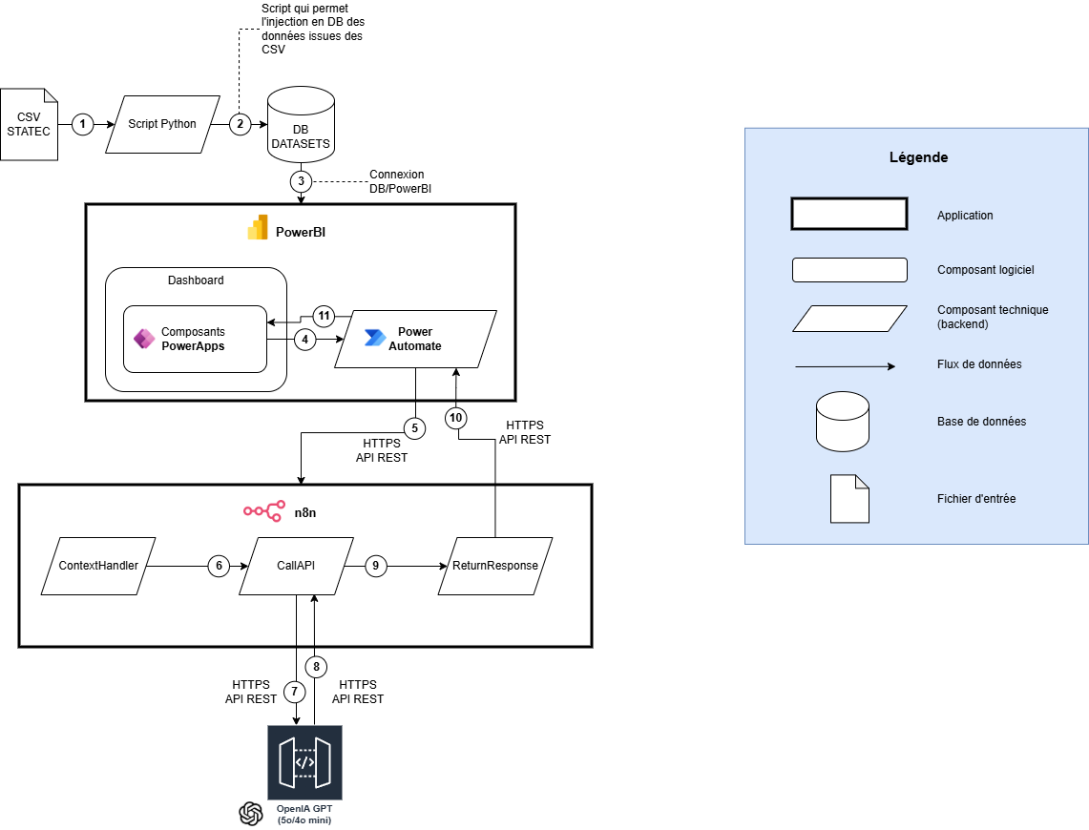
Architecture technique
STRUCTURE
Présentation - 100% gratuit - Microsoft
PowerBI : Dashboard
PowerApps : Champ de texte
PowerAutomate : Flux entrant/sortant
Middleware – N8N
N8N : Gère les flux entre le front et l’IA
Aucune architecture technique nécessaire
IA - API OpenAI
1 requête = 400-800 tokens
1M input tokens (sur GPT4.o mini) = 0,15$
1M output tokens (sur GPT4.o mini) = 0,6$
1 requête = environ 1 centime d’euros
Aucun frais supplémentaire – 100% pay per use

